Slide 1
COMP6049 – Algorithm Design and Analysis
Topic 8 – Graph

Slide 2
Outline Materials
Types of graph
Implementation of graph using cost adjacency matrix
Implementation of graph using cost adjacency list

Slide 3
GRAPH
Graph is an ADT which consists of a set of nodes (points) and edges (lines).
An edge connects 1 or 2 nodes.
Edge, which only connect a node is called a loop edge.
Graph Type:
Directed Graph
Also referred to by the term digraph.
Undirected Graph

Slide 4
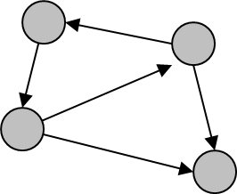
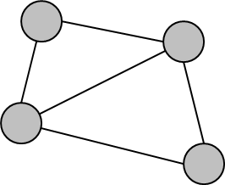
DIRECTED vs UNDIRECTED
Directed Graph
Undirected Graph

Slide 5
DEGREE OF NODE
In degree x is the number of edges coming into node x.
Out degree x is the number of edges out of node x.
A node that all its outward edge is called source.
A node that all its leading edge into is called sink.
In Undirected Graph there is only 1 degree nodes, which is a lot of side (edge) which cross on that node.

Slide 6
GRAPH REPRESENTATION
Graph can be represented in:
Illustrations
Linked-list
Adjacency matrix (and Cost Matrix)
Adjacency matrix: the proximity between two nodes
Adjacency matrix is made by calculating the adjacency list

Slide 7
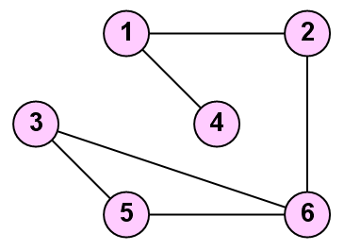
ADJACENCY LIST
A[1,2]=1
A[1,3]=0
A[1,4]=1
A[1,5]=0
A[1,6]=0
A[2,3]=0
A[2,4]=0
A[2,5]=0
A[2,6]=1
A[3,4]=0
A[3,5]=1
A[3,6]=1
A[4,5]=0
A[4,6]=0
A[5,6]=1

Slide 8
ADJACENCY LIST
The class definitions in C++ for the adjacency list representation are
Class Graph
{
private:
int n; //number of vertices
struct node {
int vertex;
struct node* link;
};
struct node* headnodes[n+1];
public:
Graph()
{ for (int i=1;i<=n;i++) headnodes[i] = NULL; }
};

Slide 9
EXAMPLE ADJACENCY MATRIX (1)
0 1 0 1 0 0
1 0 0 0 0 1
0 0 0 0 1 1
1 0 0 0 0 0
0 0 1 0 0 1
0 1 1 0 1 0

Slide 10
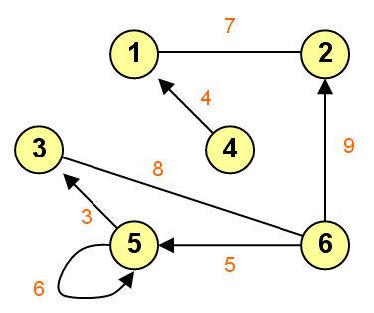
EXAMPLE ADJACENCY MATRIX (2)
0 7 0 0 0 0
7 0 0 0 0 0
0 0 0 0 0 8
4 0 0 0 0 0
0 0 3 0 6 0
0 9 8 0 5 0

Slide 11
COST MATRIX
If the adjacency matrix shown in proximity, then the Cost Matrix seen in the distance.
If there is no edge connecting
Adjacency matrix is 0
Cost Matrix valued ∞

Slide 12
EXAMPLE COST MATRIX
∞ 7 ∞ ∞ ∞ ∞
7 ∞ ∞ ∞ ∞ ∞
∞ ∞ ∞ ∞ ∞ 8
4 ∞ ∞ ∞ ∞ ∞
∞ ∞ 3 ∞ 6 ∞
∞ 9 8 ∞ 5 ∞

Slide 13
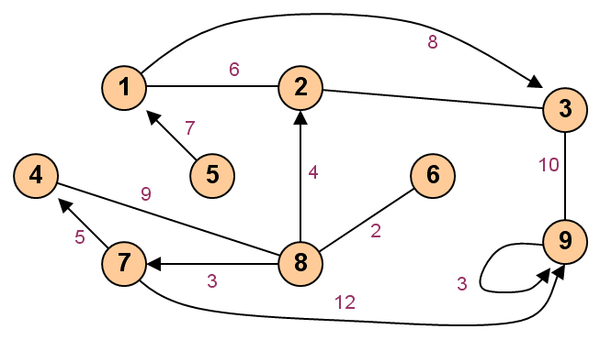
EXERCISE
Please produce the Adjacency Matrix and the Cost Matrix!

Slide 14
EXERCISE
Draw a tree with 14 vertices
Draw a directed acyclic graph with 6 vertices and 14 edges
Suppose that your computer only has enough memory to store 40000 entries. Which best graph data structure(s) – you can choose more than 1 -- should you use to store a simple undirected graph with 200 vertices, 19900 edges, and the existence of edge(u,v) is frequently asked?
Adjacency Matrix
Adjacency List
Edge List

Slide 15
REVIEW
GRAPH
DIRECTED vs UNDIRECTED GRAPH
DEGREE OF NODE
GRAPH REPRESENTATION
ADJACENCY LIST
COST MATRIX

Slide 16
Q & A

Slide 17
References
S. Sridhar. 2014. Design and Analysis of Algorithms, 1/e. Oxford University Press. India. Chapter 5.6
Ellis Horowitz,Sanguthevar Rajasekaran,Sartaj Sahni. 1998. Computer algorithms/C++. 1STBL. New York. Chapter 2.6
Graph and its representations
http://www.geeksforgeeks.org/graph-and-its-representations/

Slide 18
THANK YOU

